Slide 1

Pioneers of Catan
Group 8

Slide 2
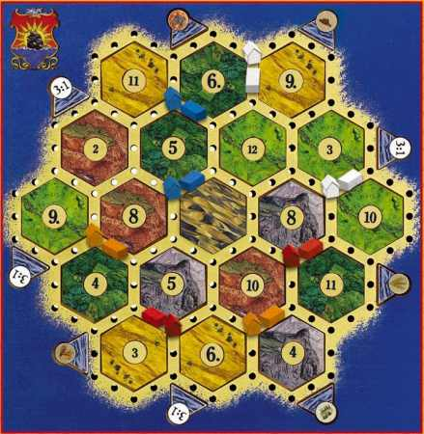
What is Catan?

Slide 3
Project Description
-Settlers of Catan Number Randomizer. Our objective for this project will be to focus on creating a mobile app that randomizes the numbers on the Settler’s of Catan Board.

Slide 4
Important Requirements
1) XAMPP - PHP Apache distribution environment - Development tool to use localhost like a remote host to test developed web code.
2) PHPStorm IDE- Cross-platform integrated development environment for PHP - Necessary for general coding development and testing
3) GIT - Distributed revision control system -Used to clone local repository in conjunction with RedHat cloud app.
4) Red Hat OpenShift Cloud - Cloud environment - Linked with XAMPP testing environment
5) GroupMe Messaging Application- Group Communication - Used to communicate with other team members about particular issues or duties that may arise during project development

Slide 5
Possible Risks
Development
Technology
Organizational
Legal

Slide 6
Project Breakdown
Application Idea Creation
Optimize System Environment (IDE)
Begin Application Development
Begin Preparing Presentation
3) Test/Debug Application
4) Deploy/Present Application

Slide 7
Project Plan
Purpose: To create an application that can generate a visual representation of a Settlers of Catan board, given certain parameters, and obeying game rules that ensure that the board is randomized as well as playable.

Slide 8
Project Approach
-Rapid Application Development Methodology (RAD)
- Main focus: efficiency
- RAD will ensure we fulfill project requirements in shortest time span possible.

Slide 9
Project Phases
-Phase I: Planning the initial requirements and goals for the final product.
-Phase II: Analyzing the requirements for each of our versions, and assigning technical duties to each individual member.
-Phase III: Design and demonstration of each successive version and our prototypes.
-Phase IV: Once our prototypes have reached a certain standard, the final version will be created to represent our finished product, and showcased out in a final demonstration.

Slide 10
Project Timeline
-Planning – January 12 to February 5
-Analysis – February 5 to February 19
-Design – February 19 to March 20th
-Implementation – March 20th to April 23
-Closeout & Maintenance – April 23 to April 30

Slide 11
Project Roles
Project Sponsor- Thuan Nguyen -Review Project Reports at each stage of the project and provide feedback
Project Manager - Binet Lee - Manages project in accordance to the project plan
Team members - Steven Borik, Caroline Personius, Rodolfo Zolezzi,Stephen Strack, Matthew Wallace, Adam Samadazda- Communicate project goals, status and progress to each other and the Project Manager

Slide 12
Issue Management
Step 1: As soon as a change which impacts project scope, schedule, staffing or spending is identified, the Project Manager will notify the Team Members.
Step 2: The Project Manager will review the change and determine the associated impact to the project and will forward the issue, along with a recommendation, to the Team Members for review and recommendations.
Step 3: Upon receipt, the Team Members should reach a consensus opinion on whether to approve, reject or modify the request based upon the information contained within the project website, the Project Manager’s recommendation and their own judgment.
Step 4: After the Team Members have submitted their feedback to the Project Manager, the Project Manager will make a final decision on what plan to implement.

Slide 13
Communication Plan
Facebook Group
GroupMe App
eLearning/Email

Slide 14
Project Assumptions
- All team members will have consistent internet access.
- All team members will have means of transportation to UT Dallas until project completion.
- Critical development software such as Git Bash will continue to be functional through developer updates and bug fixes.
- Catan players are interested in optimizing the board setup.
- Upper level decision makers (Professor, TA) will approve of the proposed project and allow for development.
- Project team members will receive continued training in mobile web development through UT Dallas coursework.
- Project team leaders will assign tasks which will be completed on time by all project team members.
- The team will be able to acquire a relevant domain name through a web hosting service or other means.
- The legal owners of Settlers of Catan will not pursue legal action against the team in response to the team’s application.

Slide 15
Project Constraints
- Project Deadline
- Limited coding capabilities
- Internet dependability
- Schedule confliction between group
- Computer dependent

Slide 16
Design Goals
Pioneers of Catan board layout randomizer for 2, 3, or 4 players
Quick, reliable output
User Interface that is easy to understand and use
Place for user to contact the designers with questions or concerns
Place for users to leave feedback about the website and randomizer

Slide 17
User Interface
Home Page
- Settlers of Catan map layout template
- Left sidebar with optimizer options
- Completely random
- 2 player fair layout
- 3 player fair layout
- 4 player fair layout

Slide 18
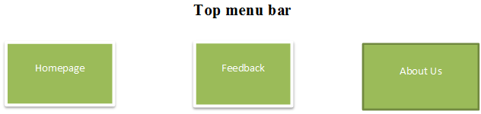
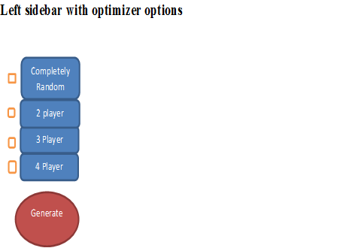
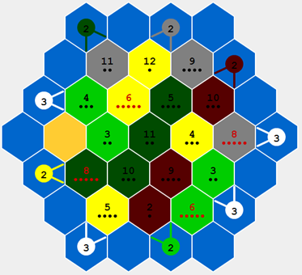
Homepage UI

Slide 19
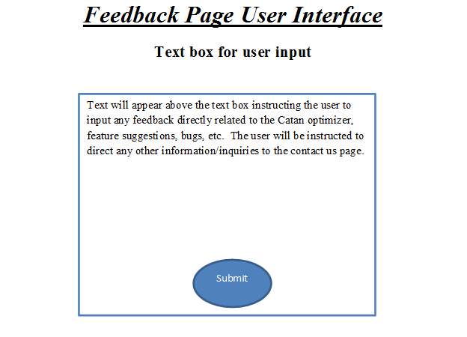
Feedback Page UI

Slide 20
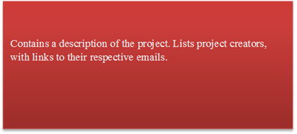
Contact Us Page UI

Slide 21
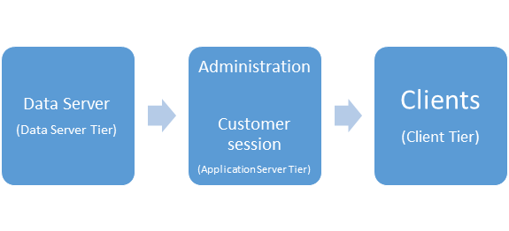
Architecture

Slide 22
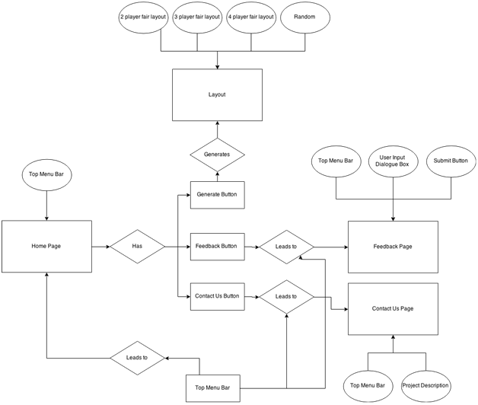
Entity Relation Diagram

Slide 23
Software Programs
Required Files:
HTML (Board image/ Randomizer button)
CSS (Stylesheet)
Javascript (Board randomizing algorithms)
PHP (Sends request from user to server)
Required Libraries/Frameworks:
jQuery/jQuery Mobile

Slide 24
Software Programs
Required Languages:
HTML5
CSS3
Javascript
PHP
MySQL

Slide 25
Software Programs
Handling user input/output:
Input- user selected Randomize button
Created with HTML/CSS
2) Output - Request sent to the server. Numbers/Tiles on board are randomized and displayed to the user.

Slide 26
Software Programs
PHP Class File
Process.php
Goal: Process the information gathered from the HTML file.
Handles input from: HTML file.
Handles output from: HTML/Javascript file.

Slide 27
Software Programs
Main methods:
GET: Sends user information to page request. (Can only accept 1024 characters)
POST : Transfers Information via HTTP Headers. (No data size restriction)

Slide 28
Software Programs
Javascript Files: Script.js
Example Function:
showImage - Displays each number once each image in the array has been randomized.

Slide 29
Database
Will be using two databases
Local MySQL database managed by the phpMyAdmin tool (Test environment)
Cloud MySQL database managed by the cloud-based phpMyAdmin tool (Deployment environment)

Slide 30
Database Tables
*The local and cloud databases are identical, local serves as the test environment. Both are newly created.
Settler Board
Land Tiles
Land Probabilities
Port Probabilities

Slide 31
Database: Board Attributes
Purpose: Serve as the main complete entity that contains objects that are then showed to end-users
Board ID (PK)
Unique integer identifier for each board instance
Boards can be stored and brought up for later use if wanted

Slide 32
Database: Land Attributes
Purpose: Individual land tiles that make up the board
Tile ID (PK)
Unique identifier for each board instance
Board ID (FK)
Board to which the Tile populates
Land Probability ID (FK)
String identifier associating probability with tile
Tile Type
String value storing resource type, such as “Brick”, “Wheat”
Tile Location
Unique integer of value from 1-19 designating position on board

Slide 33
Database: Land Probability
Purpose: Probabilities that can be shifted on land tiles
Land Probability ID (PK)
Unique integer identifier for each probability, value of 1-18
Probability Color
Can be string value “Black” or “Red”
Two red tiles should never be next to each other on the board
Probability Values
Unique double value designating amount of value tile will provide
I.E. 6.5, when 6 is rolled, provide 5 of resource

Slide 34
Database: Harbor Probability
Purpose: Probabilities that can be shifted on water tiles
Harbor Probability ID (PK)
Unique integer identifier for each probability, value of 1-18
Also designates position on water tiles on board
Board ID (FK)
Integer value of Board that the Harbor Probability belongs to
Probability Resource Type
Can be string value designating resource type, or random value
Two red tiles should never be next to each other on the board
Ratio value
Unique string value designating exchange rate
I.E. 2:1, 2 of Probability Resource Type exchanged for 1 of any resource

Slide 35
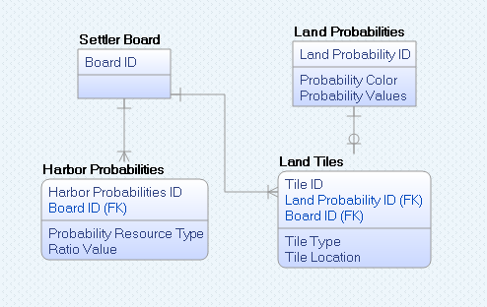
Database: Table Mapping

Slide 36
Questions?

